Slide 1



Self-assessment at school
Helena Castro Jan/FeB – Madrid - 2017

Slide 2
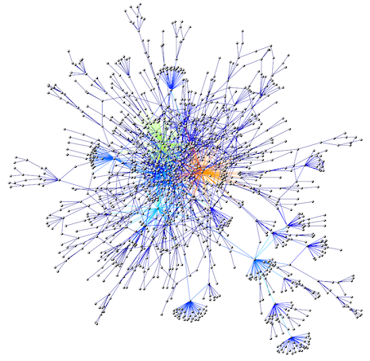
1. The Problem
A Complex field of analysis
Many personal and professional interests involved
Little time to devise tools, to collect information and handle the information collected

Slide 3
Self-assessement
Report
Improvement Plan
Report
Improvement
Plan
2. The Concept
A continuous process of improvement aiming at the vision and mission of schools in which we are all co-responsible.

Slide 4

3. Set in motion
Creation of a team with 10 highly motivated teachers from different levels of education
Usage of General Inspection of Education’s referencial to define the areas to be evaluated
Development of data collection instruments
Analysis of the data

Slide 5
3. Set in motion
Creation of a Report with an Improvement Plan
Production of instruments to verify the implementation of the Improvement Plan
New Self-Assessment Report and New Improvement Plan

Slide 6

4. Selected areas
Satisfaction of the Educational Community – Stakeholders, Parents, Students, Teachers, Intermediate leaders, Other Employees.
Quality of Educational Service - Teaching practices, assessment and curricular articulation; Class Directors, Psychology and counseling services and the Special Education teachers - impact of their actions.
Management and Leadership - satisfaction of the school community: guidelines and decisions made, relationships with people, conflict resolution.

Slide 7

5. Academical success
Another team with 5 highly motivated teachers.
Construction of a reference matrix for the analysis of school results.
Definition of Internal and external quality and efficiency indicators
At the end of each school term (3 months) an analysis report is drawn up with the reflection of all teachers and stakeholders.
The improvement strategies are defined and implemented by the teachers’ groups.

Slide 8

Conclusion
We are in a dynamic of self-learning and inspiration in the complexity of reality.
Thank you !

